Slide 1
Codd’s 12 Rules

Slide 2
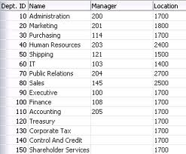
Rule 1 : The information Rule.
"All information in a relational data base is represented explicitly at the logical level and in exactly one way - by values in tables.“

Slide 3
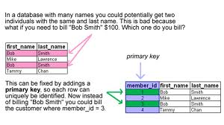
Rule 2 : Guaranteed access Rule.
"Each and every datum (atomic value) in a relational data base is guaranteed to be logically accessible by resorting to a combination of table name, primary key value and column name.“

Slide 4
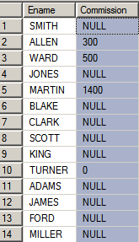
Rule 3 : Systematic treatment of null values.
"Null values (distinct from the empty character string or a string of blank characters and distinct from zero or any other number) are supported in fully relational DBMS for representing missing information and inapplicable information in a systematic way, independent of data type.“

Slide 5
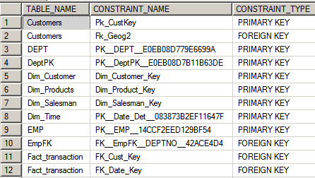
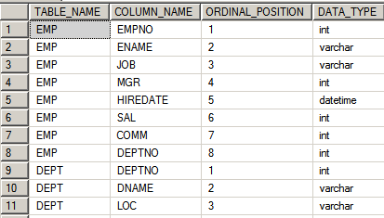
Rule 4 : Dynamic on-line catalog based on the relational model.
The database must contain certain system tables whose columns describe the structure of the database itself.

Slide 6
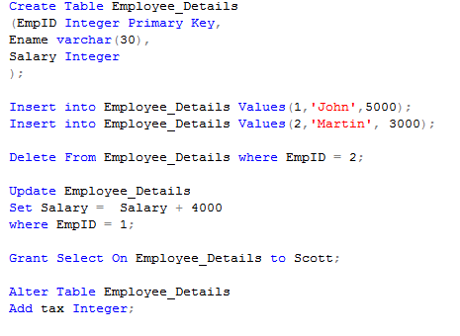
Rule 5 : Comprehensive data sub-language Rule.
Mandates using a relational database language, such as SQL, although SQL is not specifically required. The language must be able to support all the central functions of a DBMS – creating a database, retrieving and entering data, implementing database security, and so on.
SQL

Slide 7
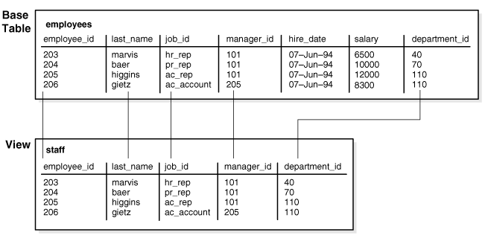
Rule 6 : View updating Rule
"All views that are theoretically updatable are also updatable by the system."
Not only can the user modify data, but so can the RDBMS when the user is not logged-in.

Slide 8
Rule 7 : High-level insert, update and delete.
Stresses the set-oriented nature of a relational database. It requires that rows be treated as sets in insert, delete, and update operations. The rule is designed to prohibit implementations that only support row-at-a-time, navigational modification of the database.
DBMS's data manipulation be able to insert, update, and delete more than one row with a single command

Slide 9
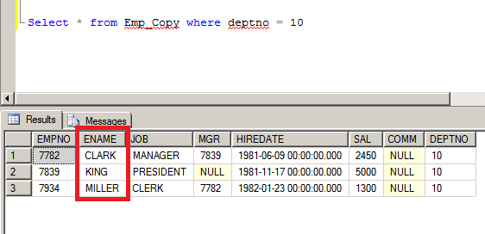
Rule 7 continued…
Example for Rule 7 → You need to delete records of deptno 10

Slide 10
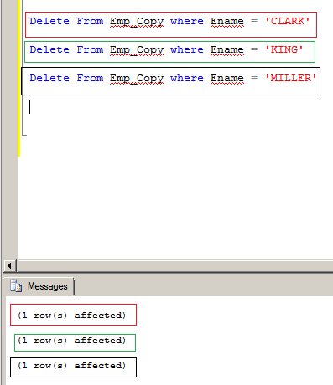
Rule 7 continued…

Slide 11
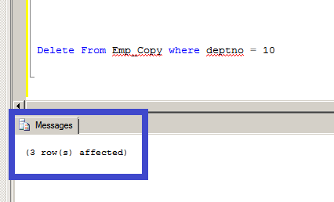
Rule 7 continued…

Slide 12
Rule 7 continued…

Slide 13
Rule 8 : Physical data independence.
"Application programs and terminal activities remain logically unimpaired whenever any changes are made in either storage representations or access methods.“
You should be able to move the database from one disk volume to another, change the physical layout of the files, and so on, without any impact on the way in which application programs and end users interact with the tables in the database.

Slide 14
Rule 8 continued…
Logical Layer → Employee table, Customers table, etc.
Physical Layer → C:\ABC\DEF\Data1.dbf data file

Slide 15
Rule 8 continued…
Logical Layer has no effect → Employee table, Customers table, etc.
Physical layer directory structure got changed
Physical Layer → D:\JKL\PQR\Data1.dbf data file

Slide 16
Rule 9 : Logical data independence.
"Application programs and terminal activities remain logically unimpaired when information-preserving changes of any kind that theoretically permit un-impairment are made to the base tables.“
Consider what happens when you add a table to a database. Since relations are logically independent of one another, adding a table should have absolutely no impact on any other table. To adhere to the logical data independence rule, a DBMS must ensure that there is indeed no impact on other tables.
Renaming a column of a table which neither a PK or FK, and that column was NOT referred in View Layer.

Slide 17
Rule 10 : Integrity independence.
"Integrity constraints specific to a particular relational data base must be definable in the relational data sub-language and storable in the catalog, not in the application programs."
If a column only accepts certain values, then it is the RDBMS which enforces these constraints and not the user program, this means that an invalid value can never be entered into this column, whilst if the constraints were enforced via programs there is always a chance that a buggy program might allow incorrect values into the system.

Slide 18
Rule 11 : Distribution independence.
A distributed database is a database where the data are stored on more than one computer. The database is therefore the union of all its parts.
In other words, a distributed database must look like a centralized database to the user. Application programs and interactive users should not be required to know where data are stored.

Slide 19
Rule 11 continued…
User1
User2
User3
Database ABC = D1+D2+D3 data files
Machine M1 has D1 data file
Machine M2 has D2 data file
Machine M3 has D3 data file

Slide 20
Rule 12 : Non-subversion Rule.
The final rule could also be called the “no cheating” rule.
When a query is fired in the database, it will be converted into low level language so that it can be understood by the underlying systems to retrieve the data.
That low level language should not do any unwanted changes in data integrity rules.

